Slide 1
Data Abstraction
Data abstraction refers to providing only essential information to the outside world and hiding their background details .
Data abstraction is a programming and design technique that relies on separation of interface and implementation .

Slide 2
BENEFITS OF DATA ABSTRACTION
By defining data members only in the private section of the class the class author is free to make changes in the data.
If the implementation changes only the class code needs to be examined to see what effect the change may have.
If data are public then any function that directly accesses the data members of the old representation might be broken.
Any c++ program where you implement a class with public and private members is an example of data encapsulation.

Slide 3
DATA ENCAPSULATION
Encapsulation is an OOP concept that binds together the data and functions that manipulate the data and that keeps both safe from outside interference and misuse.
Any c++ program where you implement a class with public and private members is an example of data encapsulation.

Slide 4
Class
A class is used to specify the form of an object and it combines data representation and methods for manipulating that data . The data and functions within a class are called members of the class.
Access specifiers:
The keyword public determines the access attributes of the members of the class that follow it. A public member can be accessed from outside the class anywhere within the scope of the class object.
A private member variable or function cannot be accessed, or even viewed from outside the class.
A protected member variable or function is very similar to a private member but it provided one additional benefit that they can be accessed in child classes which are called derived classes.
.

Slide 5
Class example
class book
{
char title[100],author[100],sub[100];
int stock,issued,code;
float price;
static int totalbooks;
public:
book();
book(int code,char title[],char author[],char sub[],float price,int stock=1000);
void getdata();
void searchbook(book b[],int &n,char title[]);
void searchbook(book b[],char author[],int &n);
void searchbook(char sub[],book b[],int &n);
void disp();
void chkstock(int );
int cstock();
};

Slide 6
Object
An object is that which has a identity,behaviour and state.
A class provides the blueprints for objects, so basically an object is created from a class.
We declare objects of a class with exactly the same sort of declaration that we declare variables of basic types.
The public members of objects of a class can be accessed using the direct member access operator (.)
Object example:
book a.book(1001,"IntrotoCplusplus“,"RVMAM“,"cplusplus“,100.0);

Slide 7
Polymorphism
The word polymorphism means having many forms..
C++ polymorphism means that a call to a member function will cause a different function to be executed depending on the type of object that invokes the function.
Polymorphism is implemented by function and operator overloading.

Slide 8
Scope resolution operator
Scope resolution operator is used to define a function outside a class or when we want to use a global variable that is hidden by a local variable of same name.
Example:
class book
{
char title[100],author[100],sub[100];
……………..
……………..
……………..
public:
book();
……………….
………………
void searchbook(char sub[],book b[],int &n);
………………
int cstock();
};
void book::searchbook(char sub1[],book b[],int &bn
{
………………………………….
}

Slide 9
Inline function
If a function is inline, the compiler places a copy of the code of that function at each point where the function is called at compile time.
A function definition in a class definition is an inline function definition, even without the use of the inline specifier.
The compiler can ignore the inline qualifier in case defined function is more than a line.
Example:
inline int book::cstock()
{
return(stock);
}

Slide 10
MACROS
The #define preprocessor directive creates symbolic constants.
The symbolic constant is called a macro and the general form of the directive is:
#define macro-name replacement-text
When line appears in a code, all subsequent occurrences of macro in that code will be replaced by replacement-text before the program is compiled.

Slide 11
Inline Vs Macro definition
The major difference between inline functions and macros is the way they are handled. Inline functions are parsed by the compiler, whereas macros are blindly replaced by the C++ preprocessor.
The fact that macros use text replacement creates the potential for bugs. Suppose we have the following code:
#define DOUBLE(X) X*X
.
.
int y = 3; int j = DOUBLE(++y);
.
. If you’re expecting that j will be assigned a value of 4 squared (16), then you would be wrong.
Because of the text replacement, what actually happens is that the DOUBLE(++y) expands to ++y * ++y, which equals 5*5, giving us 25.

Slide 12
Inline Vs Macros
Inline | Macros
Part of language easy to debug | Difficult to debug
Not always expanded | Always Expanded
Has type checking rules and scope | Does not have these
Compile time | Preprocessing

Slide 13
Constructor
A class constructor is a special member function of a class that is executed whenever we create new objects of that class.
A constructor will have exact same name as the class and it does not have any return type at all, not even void.
Constructors can be very useful for setting initial values for certain member variables.
There are three different types of constructors namely default constructor, parameterised constructor and copy constructor.
Example:
class book
{
char title[100],author[100],sub[100];
……………..
……………..
……………..
public:
book::book()
book::book(int code,char title[],char author[],char sub[],float price,int stock)
};

Slide 14
Default arguments
When you define a function, you can specify a default value for each of the last parameters.
This value will be used if the corresponding argument is left blank when calling to the function.
This is done by using the assignment operator and assigning values for the arguments in the function definition.
If a value for that parameter is not passed when the function is called, the default given value is used, but if a value is specified, this default value is ignored and the passed value is used instead.
Example:
class book
{
char title[100],author[100],sub[100];
……………..
……………..
……………..
public:
book(int code,char title[],char author[],char sub[],float price,int stock=1000)
……………………………..
………………………………
};

Slide 15
This pointer
Every object in C++ has access to its own address through an important pointer called this pointer. The this pointer is an implicit parameter to all member functions. Therefore, inside a member function, this may be used to refer to the invoking object.
Friend functions do not have a this pointer, because friends are not members of a class. Only member functions have a this pointer.
book::book(int code,char title[],char author[],char sub[],float price,int stock)
{
this->code=code;
strcpy(this->title,title);
strcpy(this->author,author);
strcpy(this->sub,sub);
this->price=price;
this->stock=stock;
totalbooks+=stock;
}

Slide 16
Parameterised constructor
A default constructor does not have any parameter, but if you need, a constructor can have parameters.
This helps you to assign initial value to an object at the time of its creation by passing the values as the parameters.
Example;
class book
{
char title[100],author[100],sub[100];
……………..
public:
book::book(int code,char title[],char author[],char sub[],float price,int stock=1000)
........................
};
book::book(int code,char title[],char author[],char sub[],float price,int stock=1000)
{
this->code=code;
strcpy(this->title,title);
strcpy(this->author,author);
strcpy(this->sub,sub);
this->price=price;
this->stock=stock;
totalbooks+=stock;
}

Slide 17
DESTRUCTOR
A class destructor is a special member function of a class that is executed whenever an object of its class goes out of scope or whenever the delete expression is applied to a pointer to the object of that class.

Slide 18
Call by reference
The call by reference method of passing arguments to a function copies the reference of an argument into the formal parameter.
Inside the function, the reference is used to access the actual argument used in the call.
This means that changes made to the parameter affect the passed argument.
Example:
void book::searchbook(book b[],int &n,char title1[])
{
…………………….
……………………
}

Slide 19
Function overloading
In function overloading, the function is said to be overloaded when same name is given to different functions.
However, the functions will differ at least in any one of the these. The number of parameters, the data type of parameters, the order of appearance these three together are referred to as the function signature.
While overloading a function, the return types of the function may or may not differ.
Example:
class book
{
char title[100],author[100],sub[100];
……………..
……………..
public:
void searchbook(book b[],int &n,char title[]);
void searchbook(book b[],char author[],int &n);
void searchbook(char sub[],book b[],int &n);
………..
};

Slide 20
Static data member
We can define class members static using static keyword.
When we declare a member of a class as static it means no matter how many objects of the class are created, there is only one copy of the static member.
A static member is shared by all objects of the class.
All static data is initialized to zero when the first object is created, if no other initialization is present.
We cannot initialise a static data member inside the class declaration but it can be initialized outside the class as done in the following example by redeclaring the static variable, using the scope resolution operator :: to identify which class it belongs to.

Slide 21
Static data member
Example:
class book
{
static int totalbooks;
……………..
public:
………………………………
};
int book::totalbooks=0;
main()
{
.....................
}

Slide 22
Static member functions
A static member function can be called even if no objects of the class exist and the static functions are accessed using only the class name and the scope resolution operator ::.
A static member function
can’t access any of the class’s non static
members or call any non static member functions
Static member functions have a class scope and they do not have access to the this pointer of the class.

Slide 23
Static member functions
Example:
class book
{
static int totalbooks;
……………..
public:
static int ret_totalstock()
{
return totalbooks;
}
};
static int totalbooks=0;
main()
{
................
cout<<“\nThe total book count is:”<<book::ret_totalstock();
................
}

Slide 24
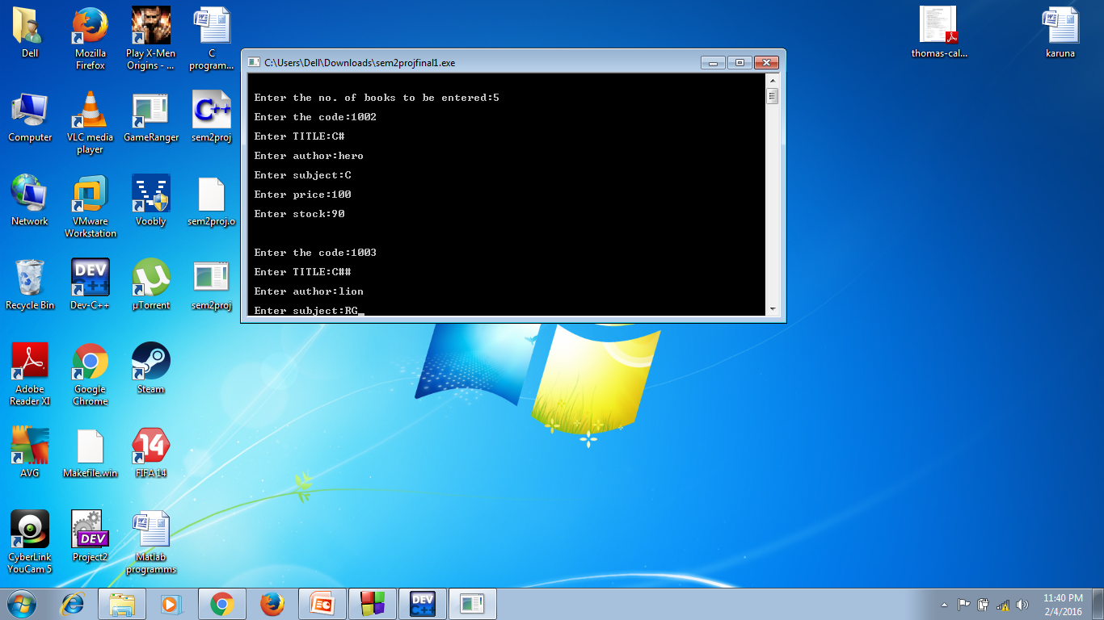
INPUT

Slide 25
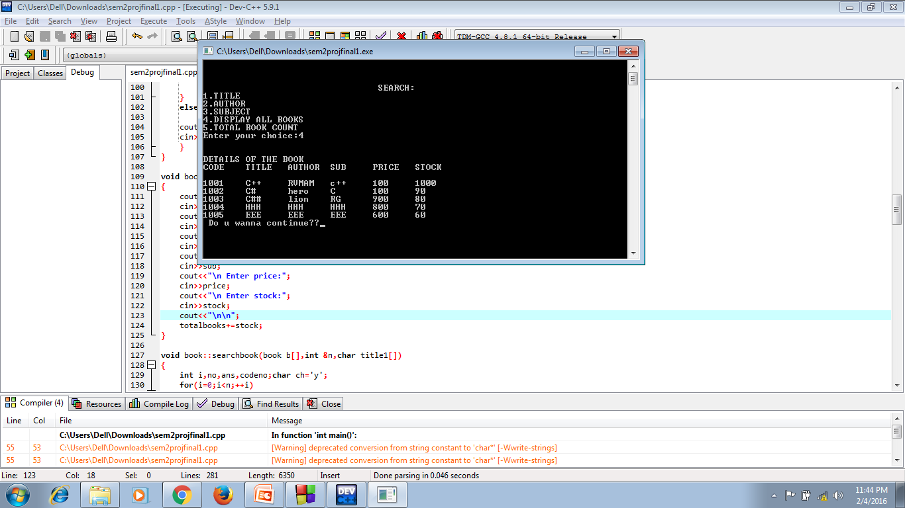
OUTPUT

Slide 26
Thank you

Slide 27
NOTE:INTERFACE
An interface describes the behavior or capabilities of a c++ class without committing to a particular implementation of the class.
The c++ interface are implemented using abstract classes.

